Slide 1


Evidences for collectivity in small systems
Mingliang Zhou
Stony Brook University
Advisor: Prof. Jiangyong Jia
Physics Ph.D. Defense
March 4th 2019

Slide 2
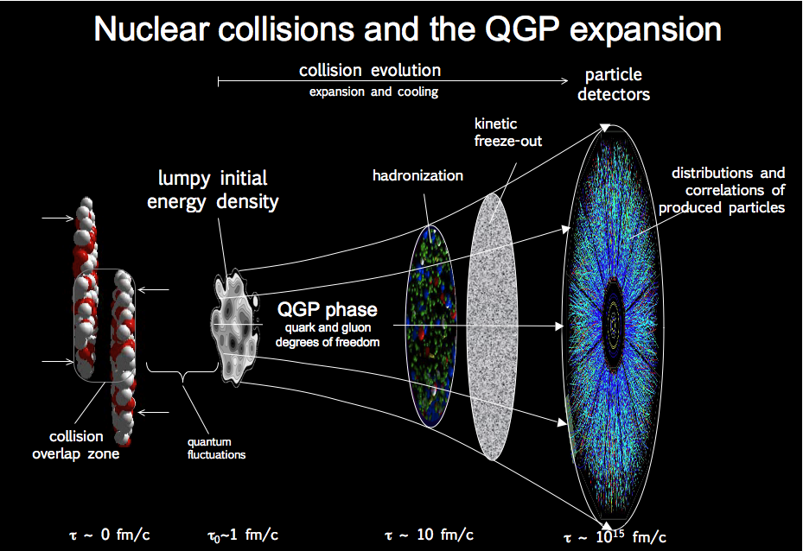
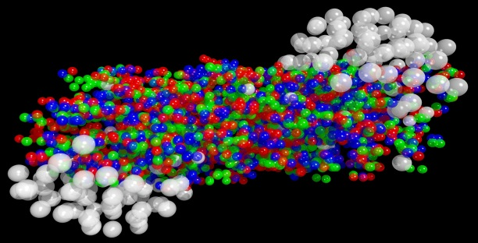
Heavy ion collision
Full picture of fireball evolution
Long-range longitudinal correlation
Long-range azimuthal correlation
Goal
Observe

Slide 3
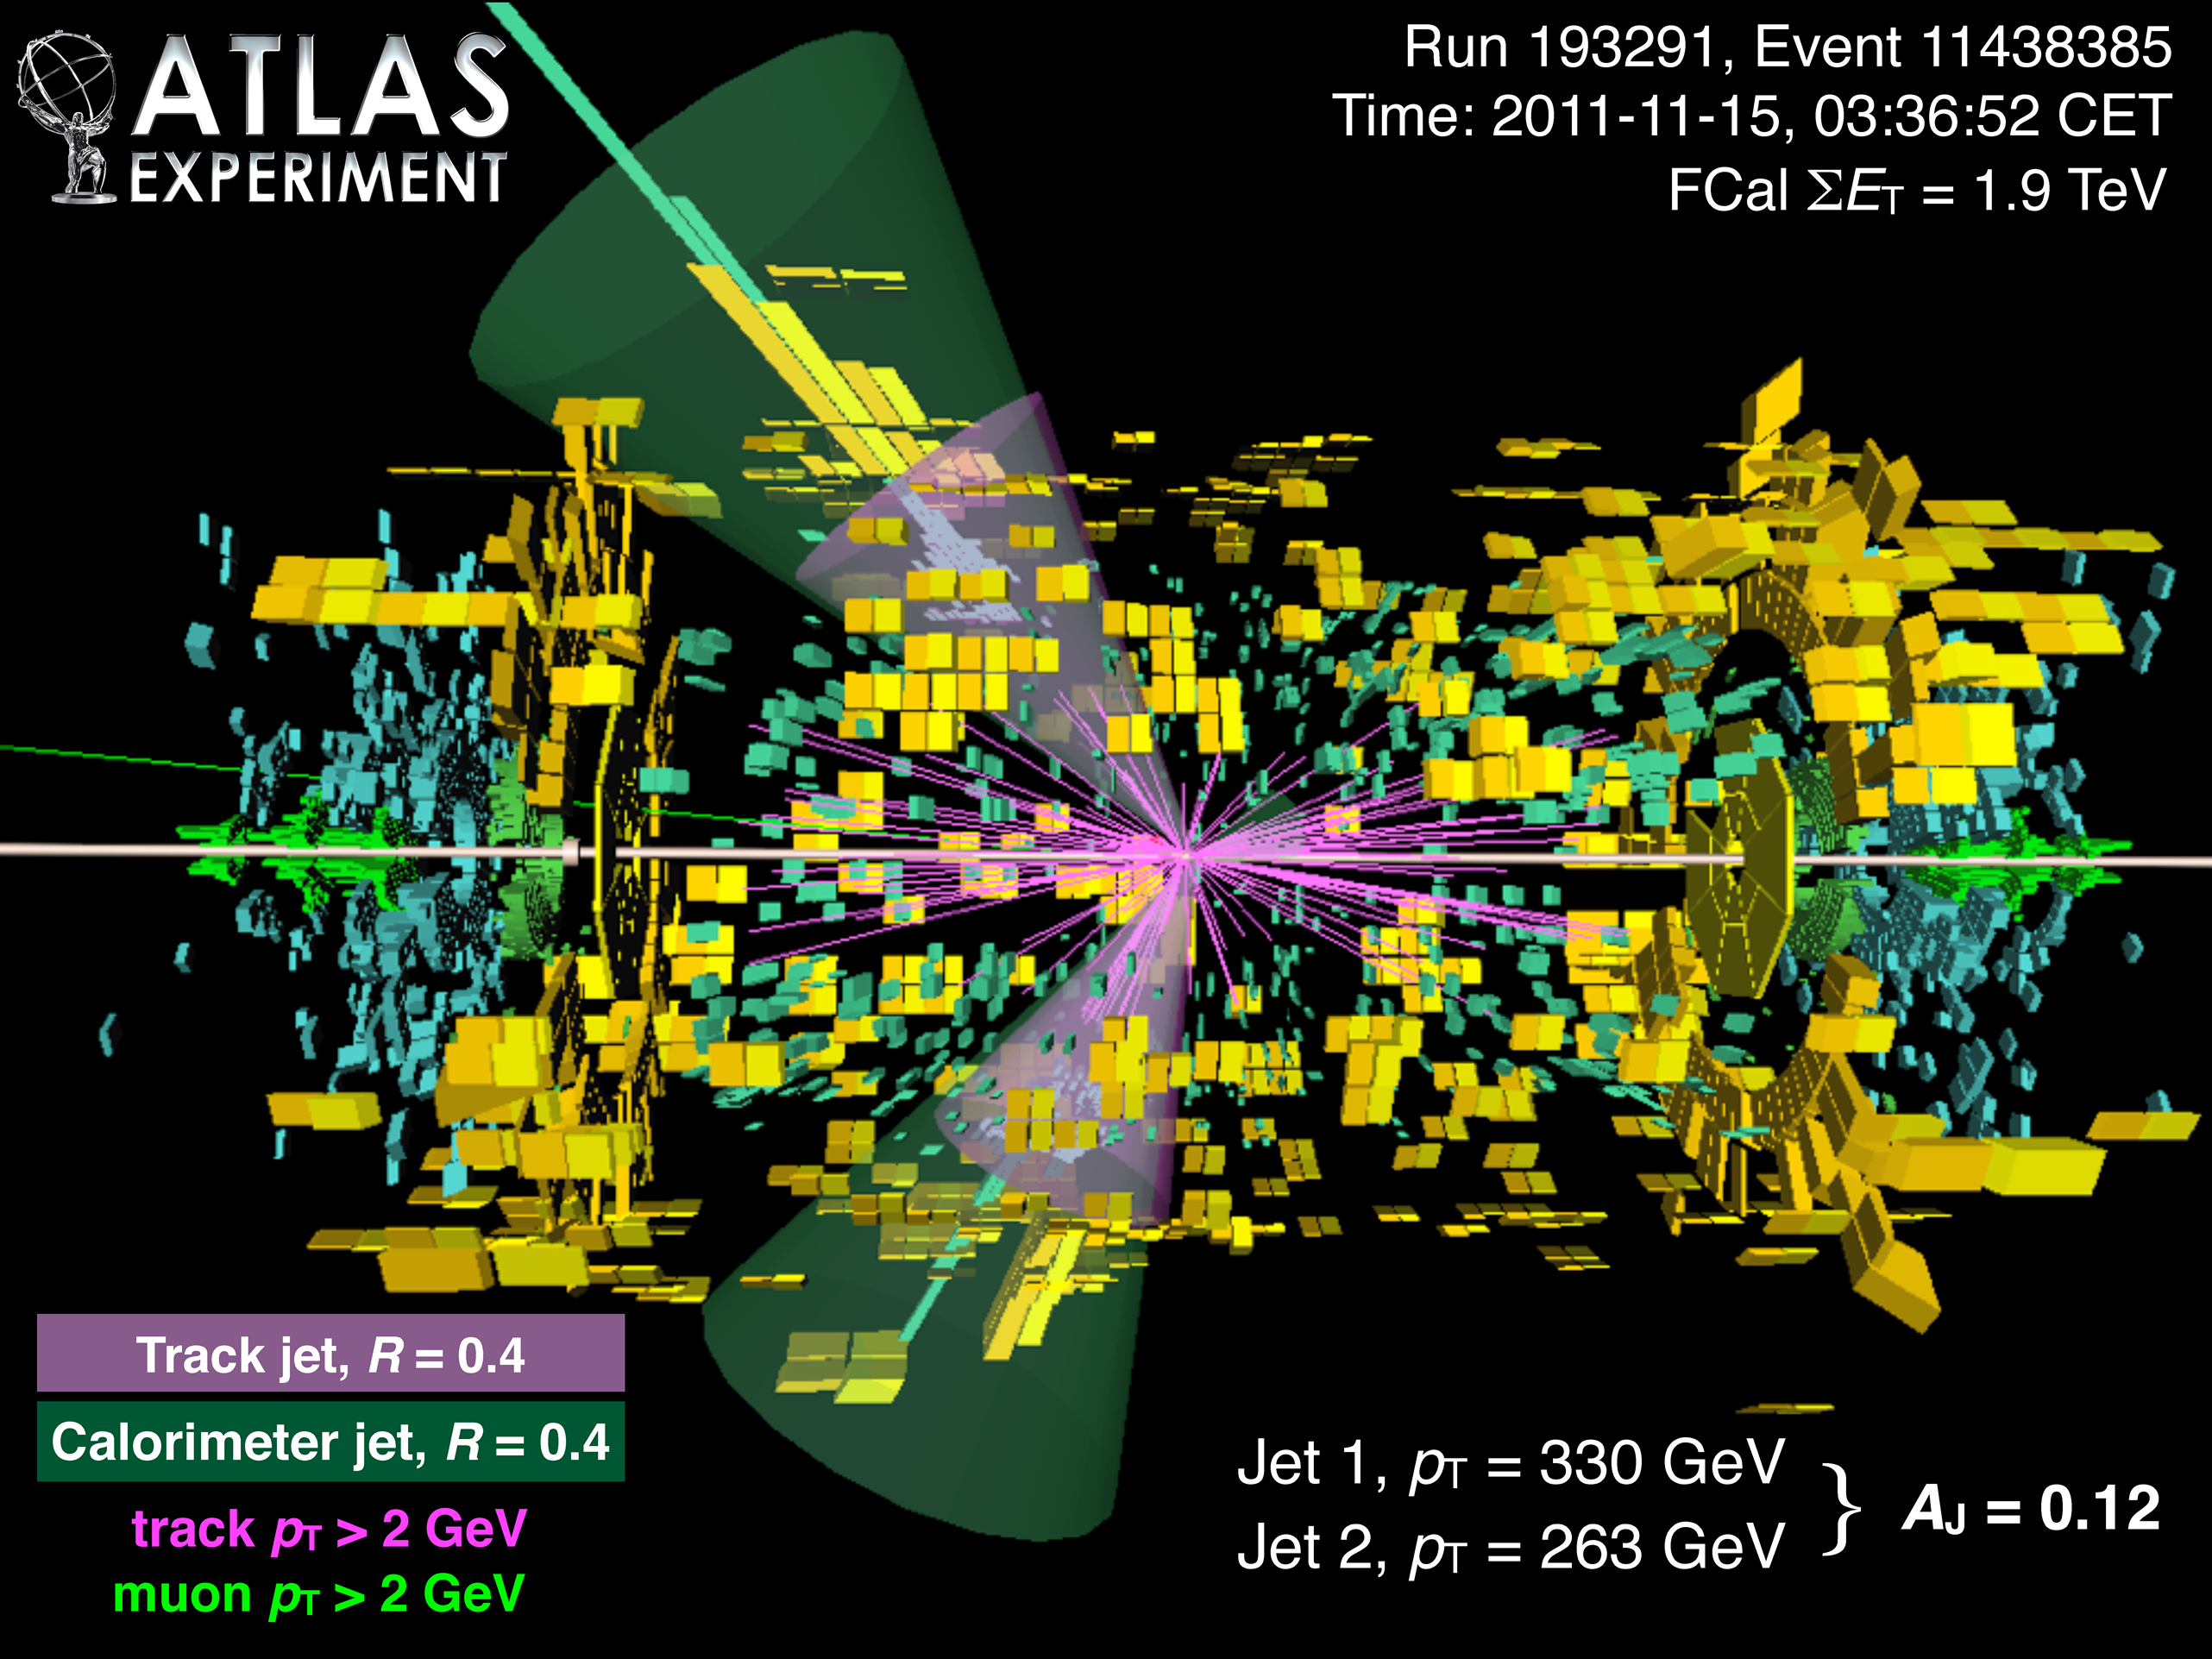
What is collectivity?
Collectivity: condition of an entity having properties its parts do not have, due to interactions among the parts.
We do not care rare events or rare particles;
We care how the system behaves as a whole.
Particles not from a common source: jet, resonance decay…
named non-flow/short-range correlation
Particles from a common source: named (long-range) collectivity

Slide 4
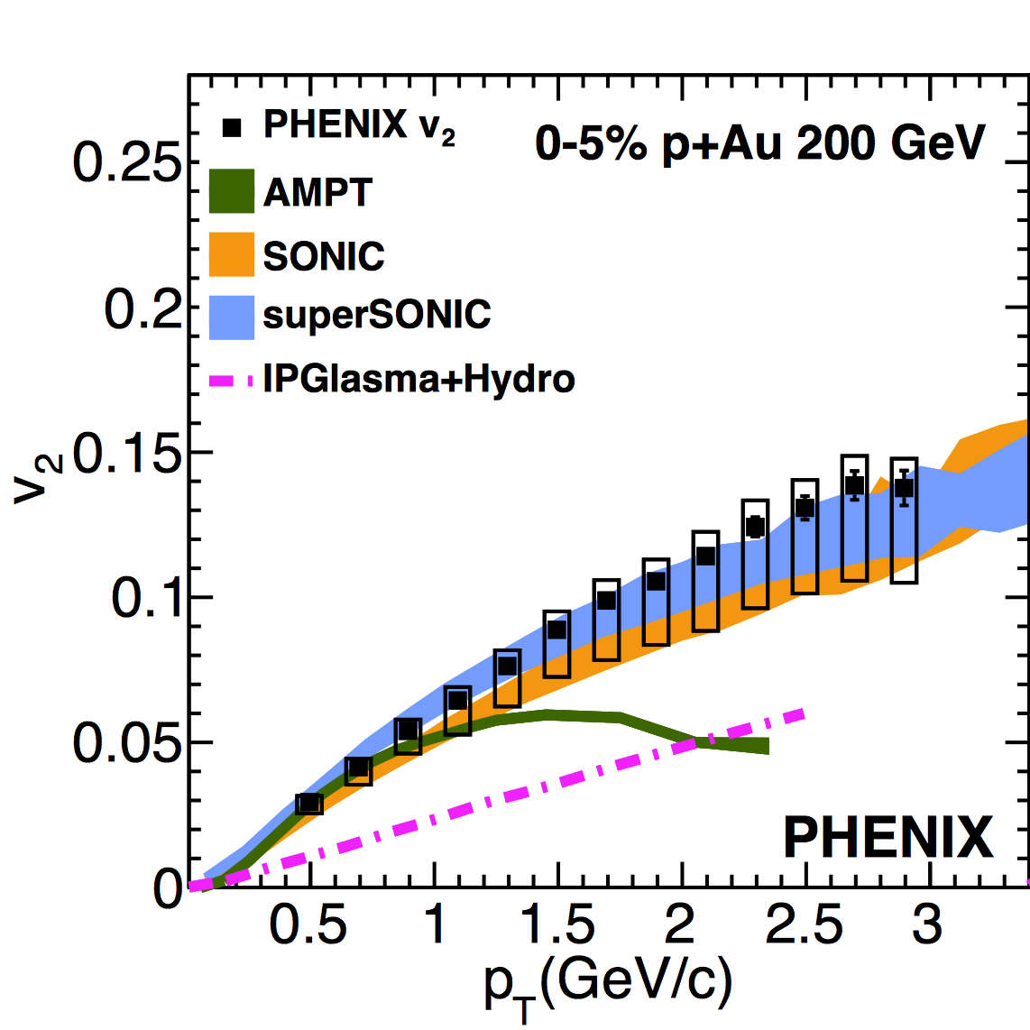
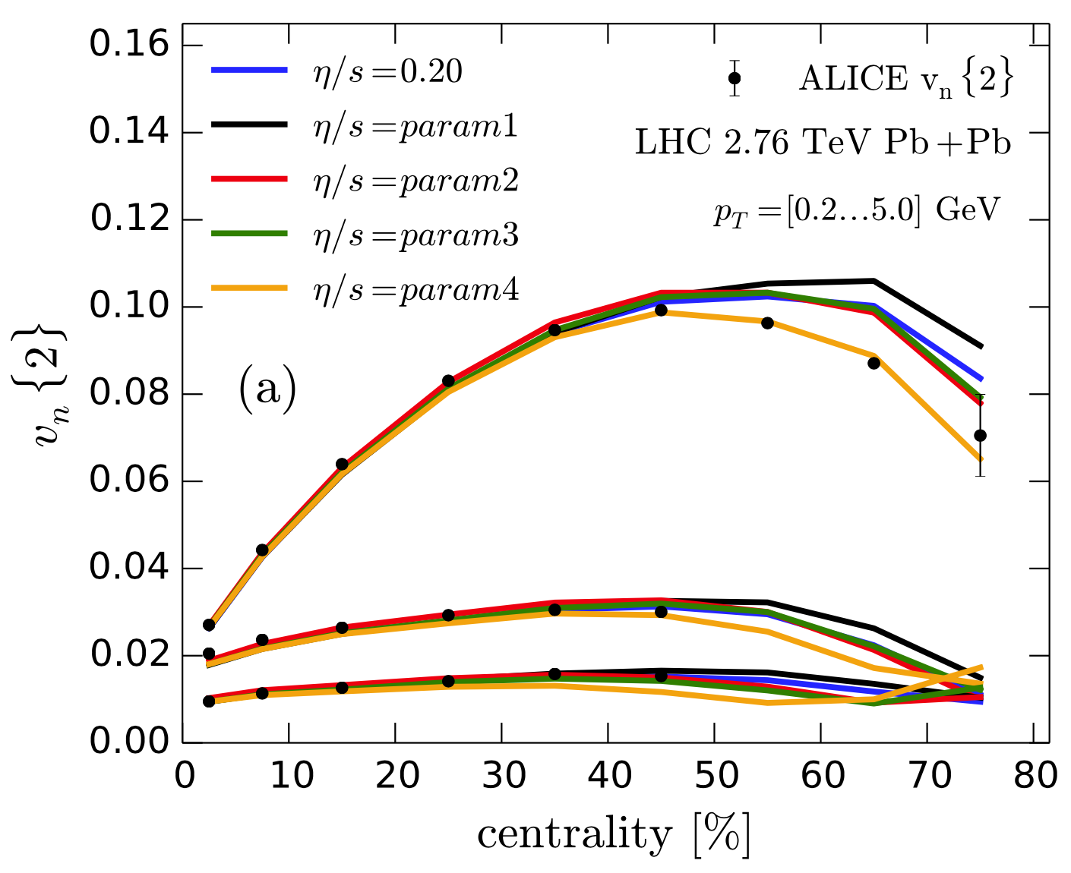
Why small systems?
Success of models in large systems;
Parameters not well constrained.
Not so good in small systems;
QGP in small systems?
Larger proton fluctuation can better distinguish different models

Slide 5

How to use data to constrain models?
Approach 1
Approach 2
param 2
param 2
Model A
Model A
new
?
data
param 1
param 1
Independent constrains
New observable
Collision system
Collision energy
Improve statistical significance of data
$pp$ and $p$+Pb events with high statistics

Slide 6
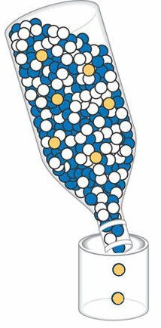
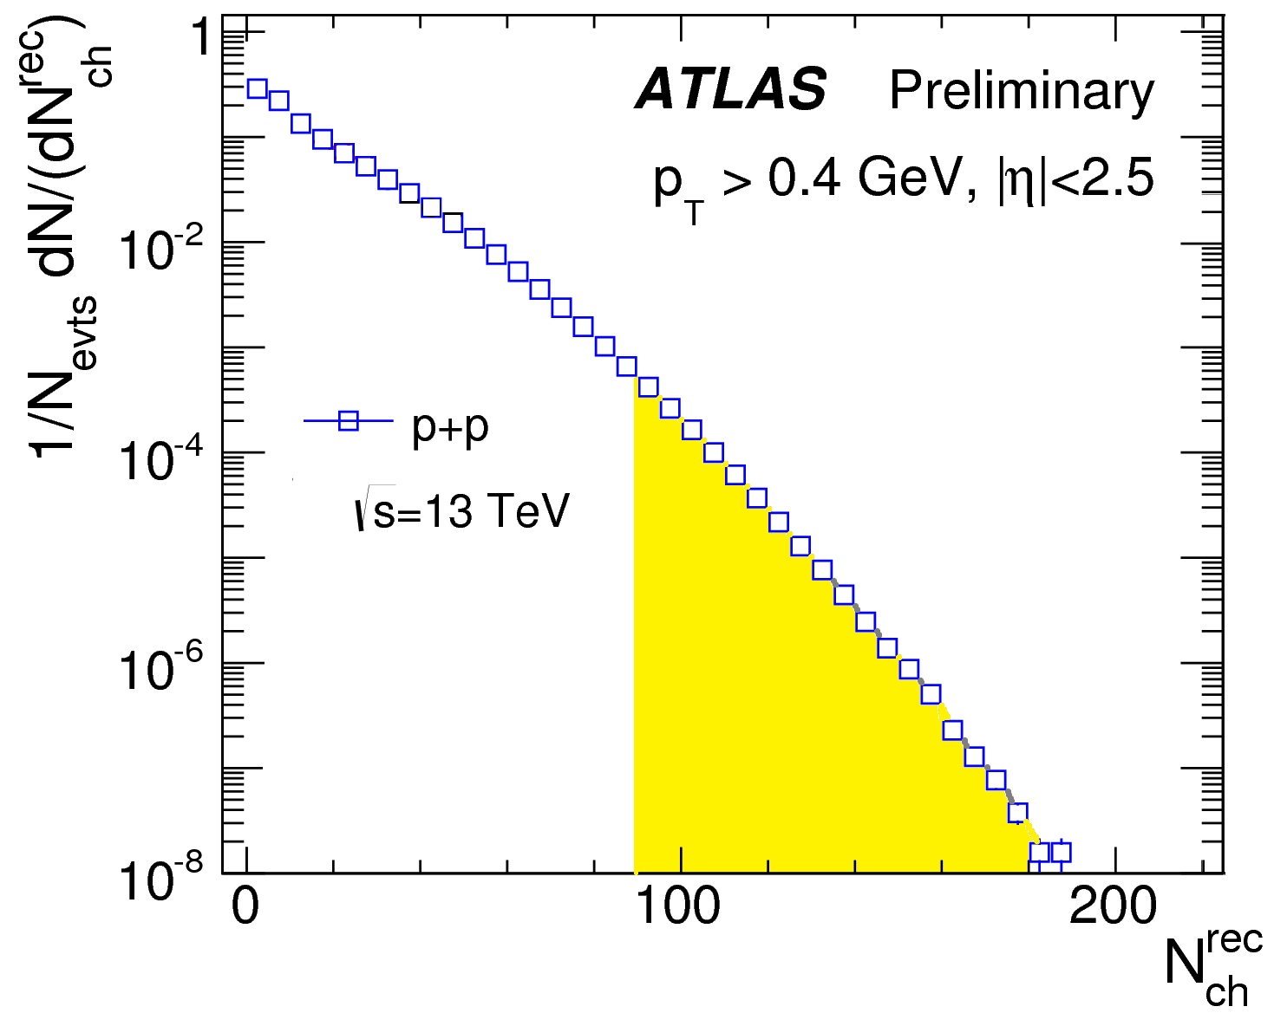
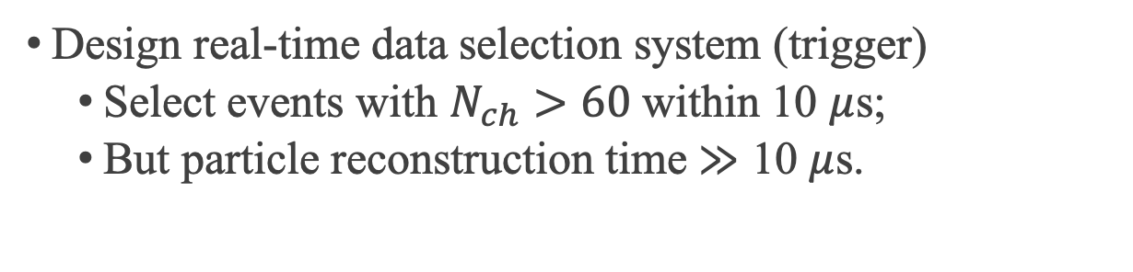
Real-time data selection
LHC event rate
40 MHz
Need more stat.
Recording cap
10 kHz
Design real-time data selection system (trigger)
Select events with $N_{ch}>60$ within 10 $μ$s;
But particle reconstruction time $≫$ 10 $μ$s.

Slide 7
Fast online track reconstruction
Var 2
HM events
All events
Var 1
Sequence and thresholds of cuts designed to maximize performance.

Slide 8
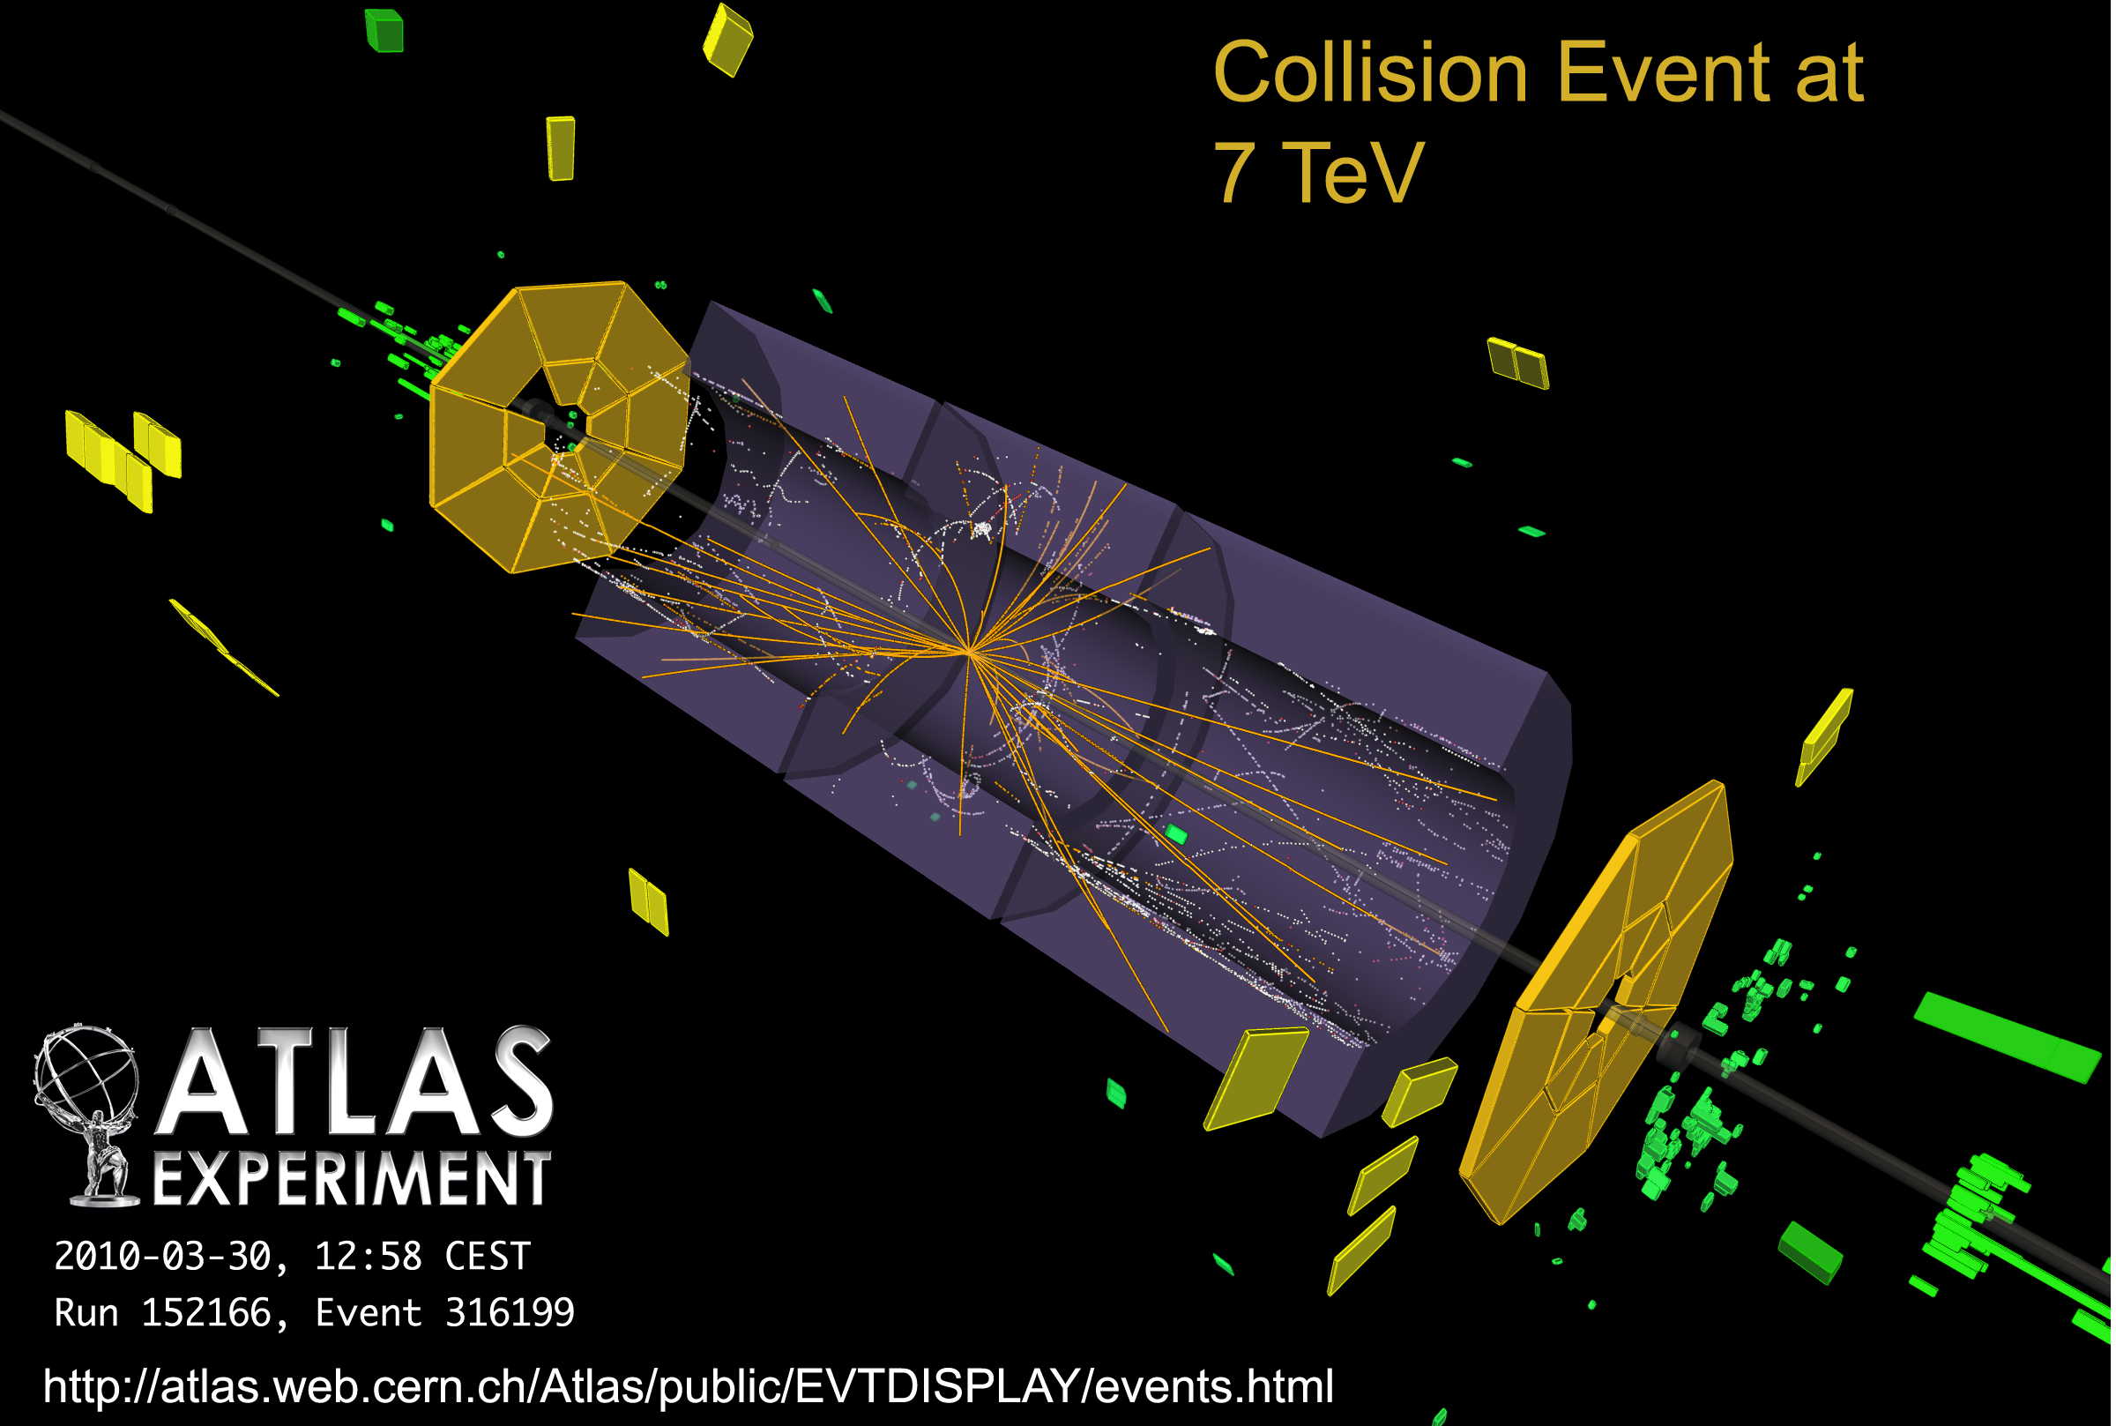
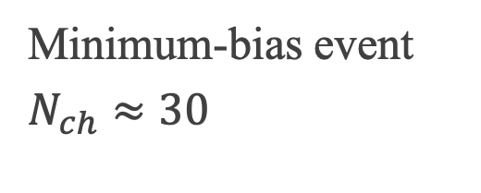
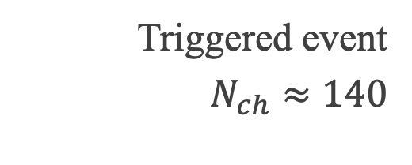
Event display
Minimum-bias event
$N_{ch}≈30$
Triggered event
$N_{ch}≈140$

Slide 9
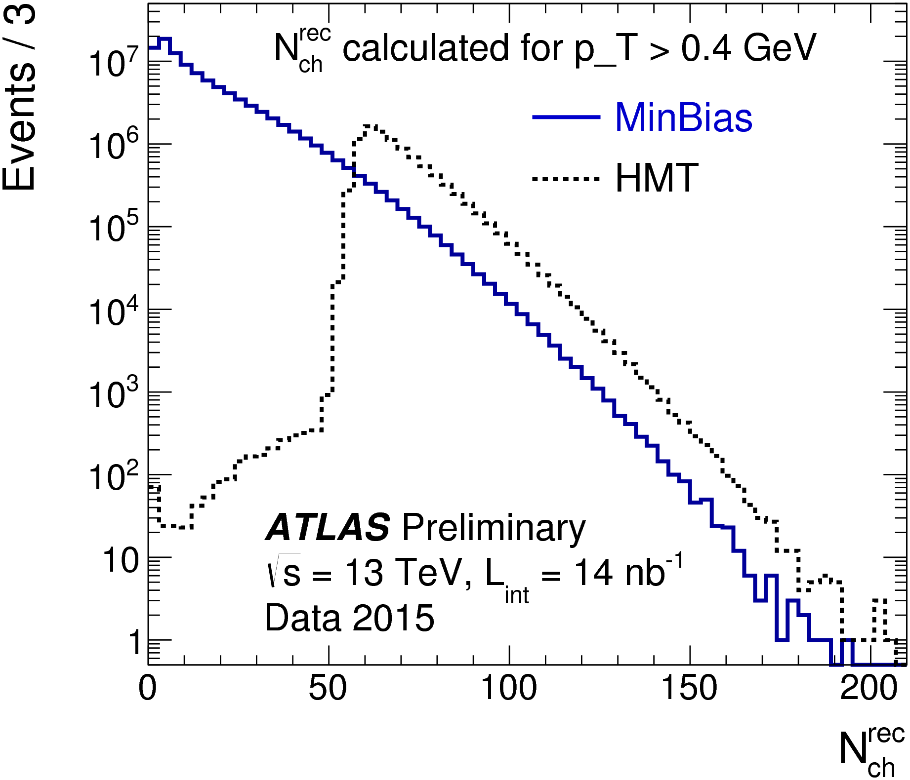
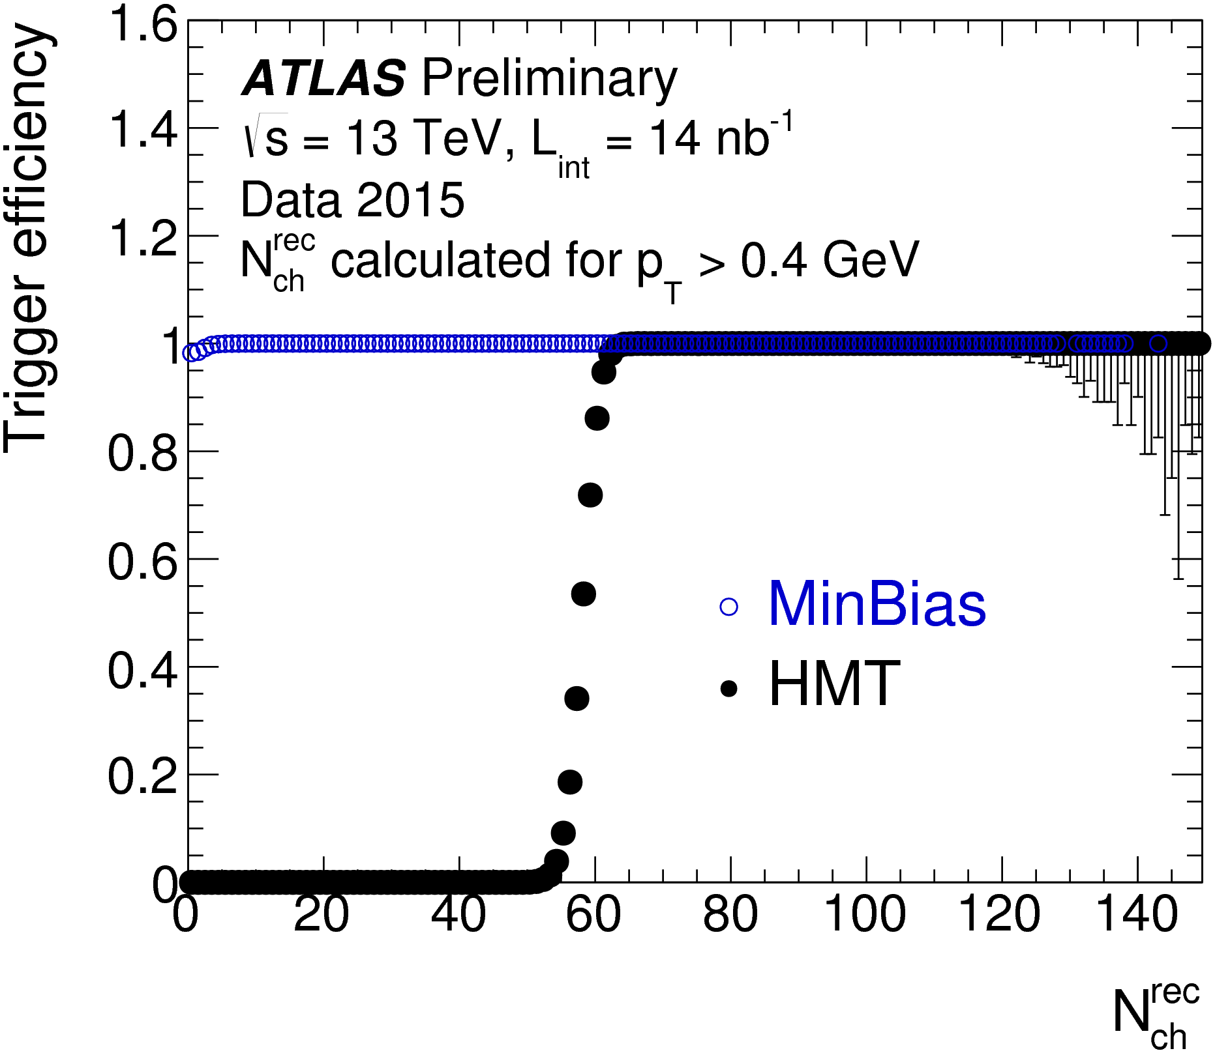
Performance
Statistics increased by x5.
Nominal bias introduced.
Multiple HMT triggers applied to $pp$ and $p$+Pb data taking

Slide 10
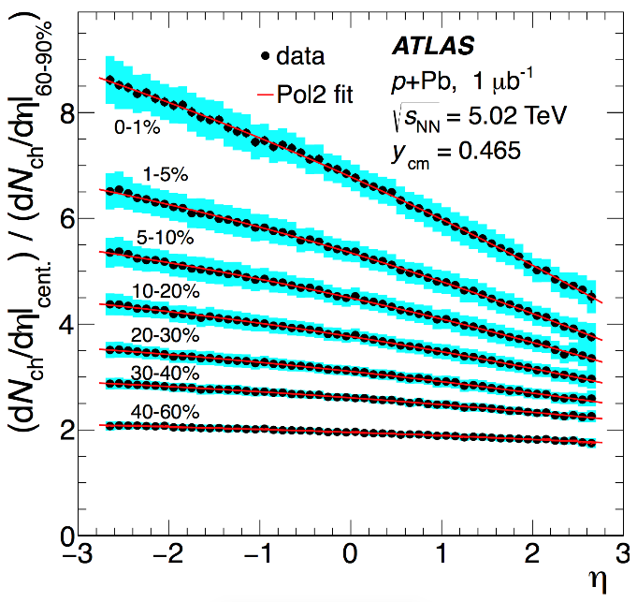
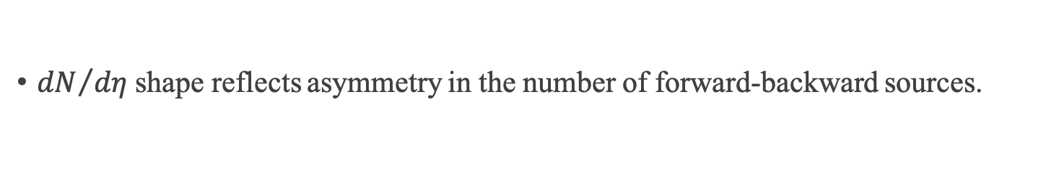
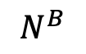
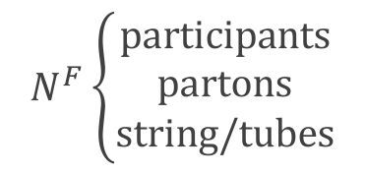
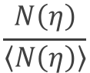
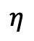
Long-range longitudinal correlation
Nature of sources seeding the long-range collective behaviors?
$$N^{F}\left\{\begin{aligned}participants \\ partons \\ string/tubes\end{aligned}\right.$$
$$N^{B}$$
${dN}/{dη}$ shape reflects asymmetry in the number of forward-backward sources.
Event-by-event multiplicity fluctuation?
Event 1
$$\frac{N\left(η\right)}{\left\langle N\left(η\right)\right\rangle }$$
Event 2
Natural asymmetry in p+Pb
$$η$$

Slide 11
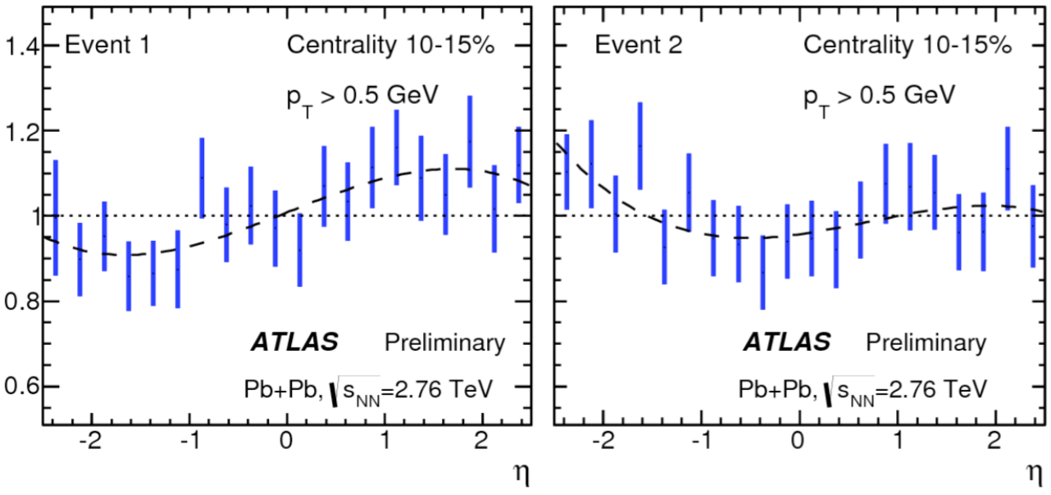
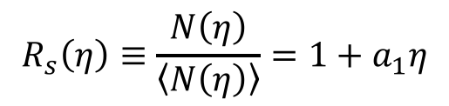
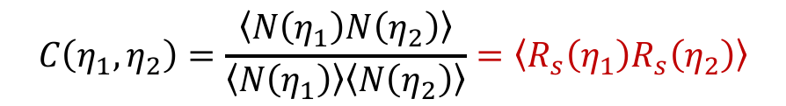
New observable
Single particle observable
$$R_{s}\left(η\right)≡\frac{N\left(η\right)}{\left\langle N\left(η\right)\right\rangle }=1+a_{1}η$$
Dominated by statistical fluctuations!
Two particles observable (correlation function)
$$C\left(η_{1},η_{2}\right)=\frac{\left\langle N\left(η_{1}\right)N\left(η_{2}\right)\right\rangle }{\left\langle N\left(η_{1}\right)\right\rangle \left\langle N\left(η_{2}\right)\right\rangle }=\left\langle R_{s}\left(η_{1}\right)R_{s}\left(η_{2}\right)\right\rangle$$
Two-particle correlation is related to single-particle distribution.
Advantage of correlation function
Disentangles dynamical fluctuation from statistical fluctuation.
Detector effects automatically removed;

Slide 12
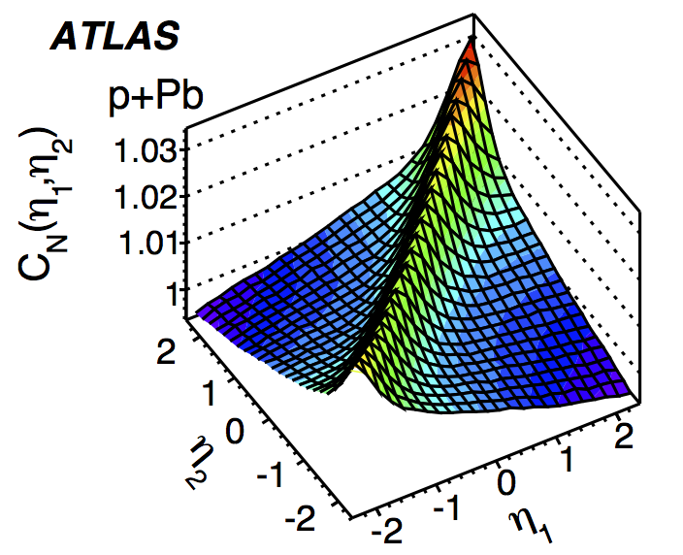
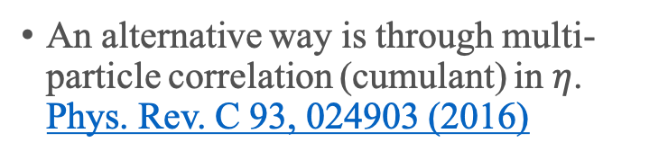
Physics signal and background
Short-range correlation reflects correlation in the different sources: jet fragmentation, resonance decay…
Since SRC has a strong charge dependence, a data-driven way was developed to remove the SRC (backup).
An alternative way is through multi-particle correlation (cumulant) in $η$. Phys. Rev. C 93, 024903 (2016)
Long-range correlation
How to quantify forward-backward fluctuation?

Slide 13
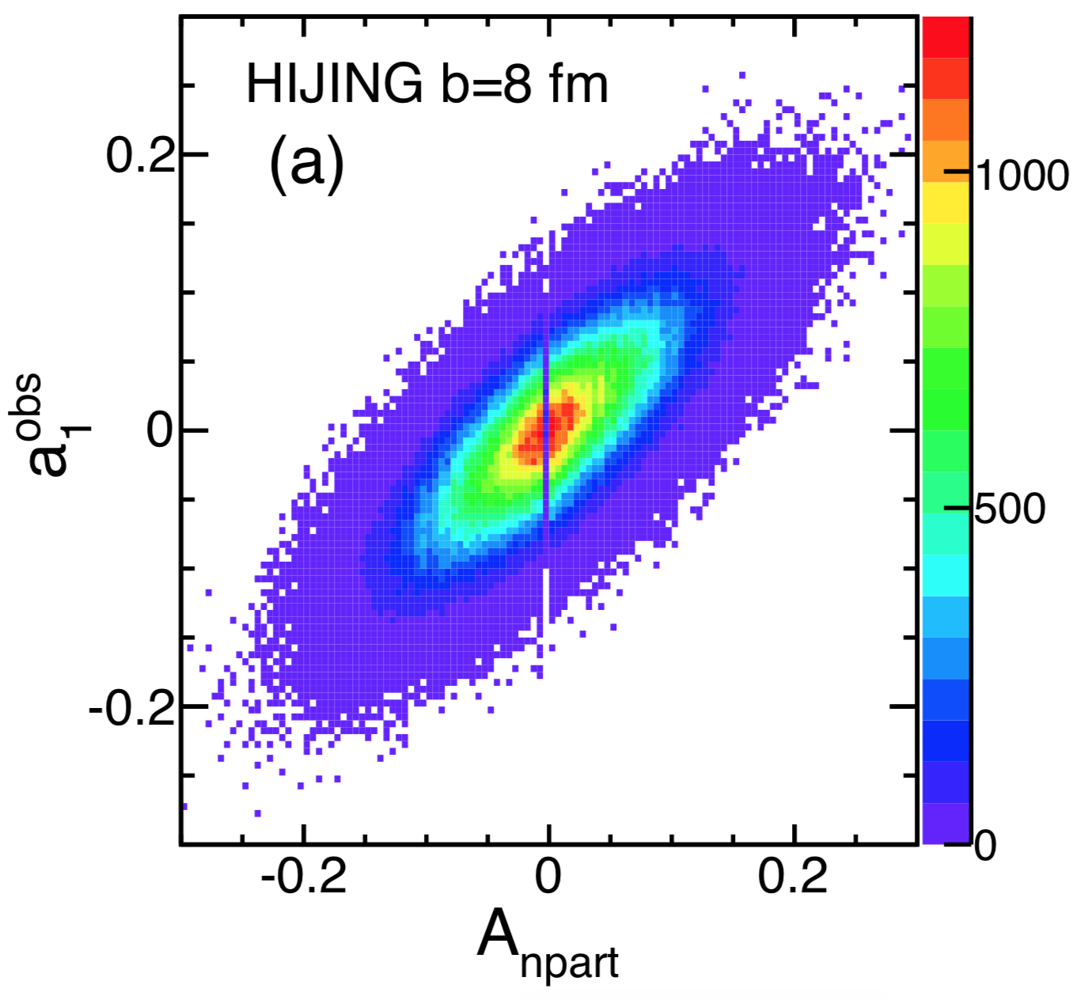
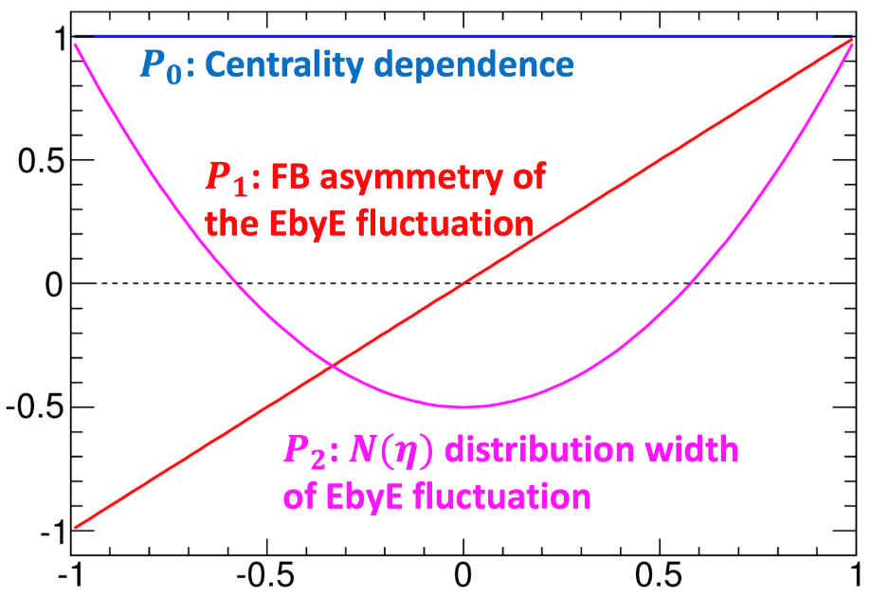
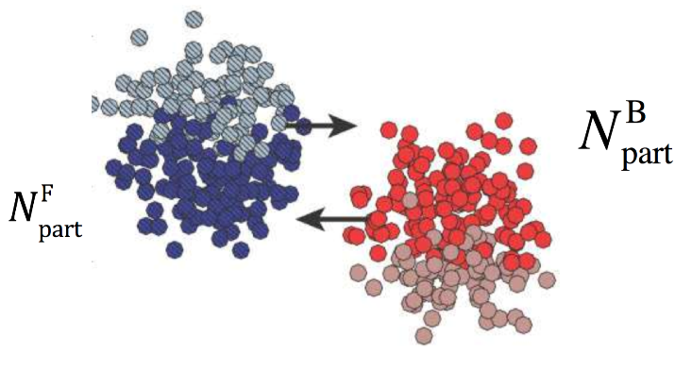
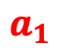
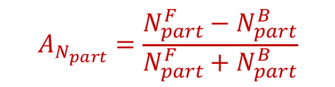
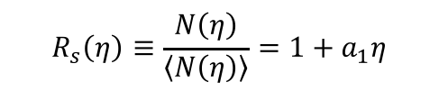
Legendre expansion: $a_{1}$
$$a_{1}$$
$$R_{s}\left(η\right)≡\frac{N\left(η\right)}{\left\langle N\left(η\right)\right\rangle }=1+a_{1}η$$
The linear shape quantifies the FB multiplicity asymmetry;
HIJING shows strong correlation between final multiplicity asymmetry and initial participant asymmetry;
As will be shown later, this component dominates the shape fluctuation.
$$A_{N_{part}}=\frac{N_{part}^{F}−N_{part}^{B}}{N_{part}^{F}+N_{part}^{B}}$$

Slide 14
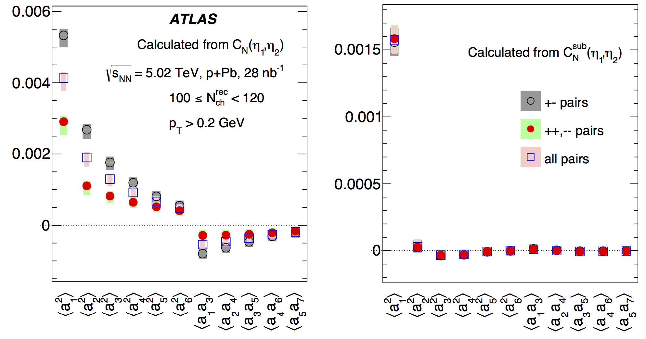
Why it is important to remove SRC?
Before SRC removal
After SRC removal
Oppo pairs
All
Same pairs
Higher order coefficients observed;
Coefficients have charge dependent;
Results hard to interpret: due to SRC!
Simpler picture after SRC removal!
LRC dominated by linear fluctuation;
LRC is charge independent.

Slide 15
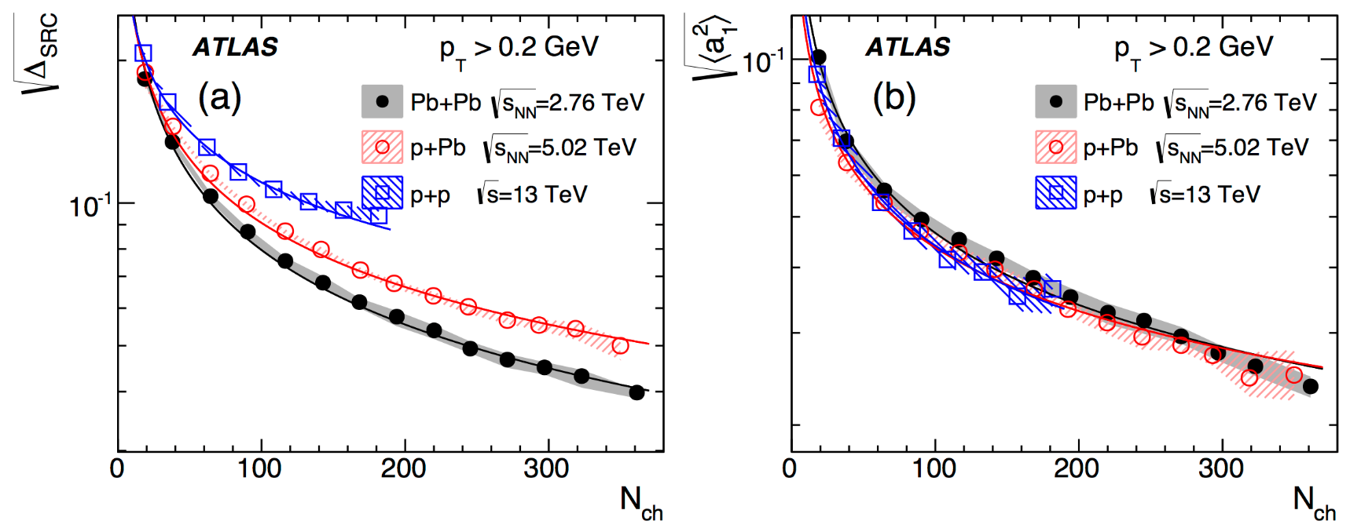
Results
SRC
LRC
SRC increases towards peripheral;
SRC is stronger in small systems;
FB fluctuation is larger in peripheral;
Independent of system size!
How will these new results help?

Slide 16
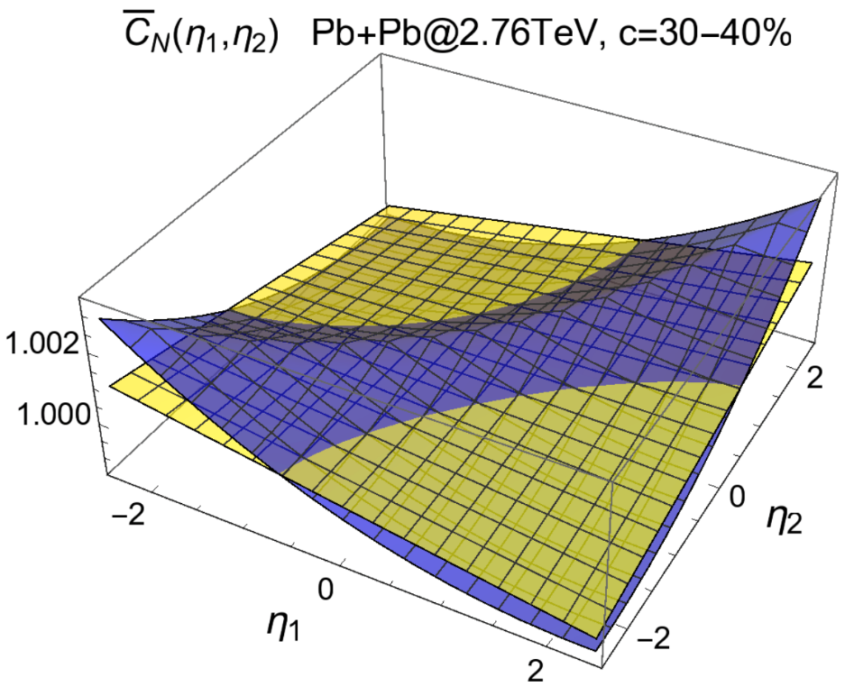
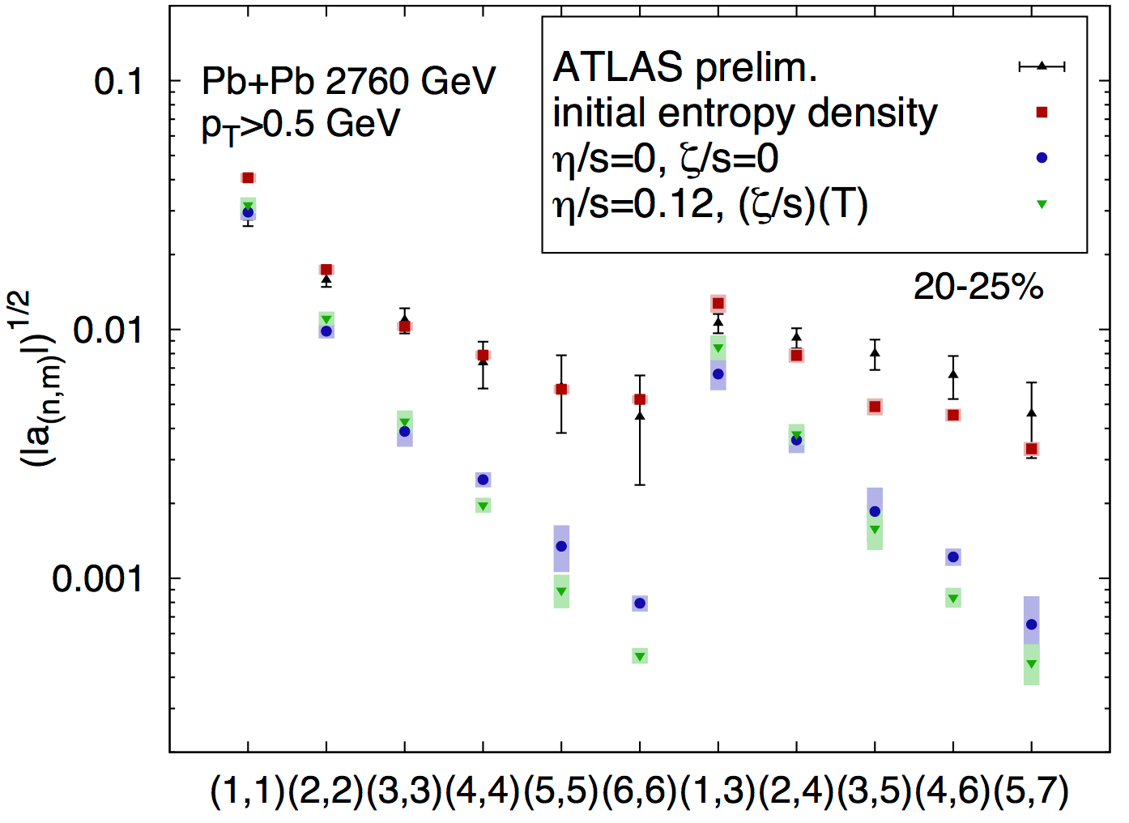
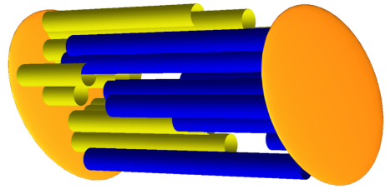
Model and data comparison
Phys. Lett. B 752 (2016) 317-321
Phys. Rev. C 93, 064910 (2016)
With length fluctuation
Hydro effect
Without length fluctuation

Slide 17
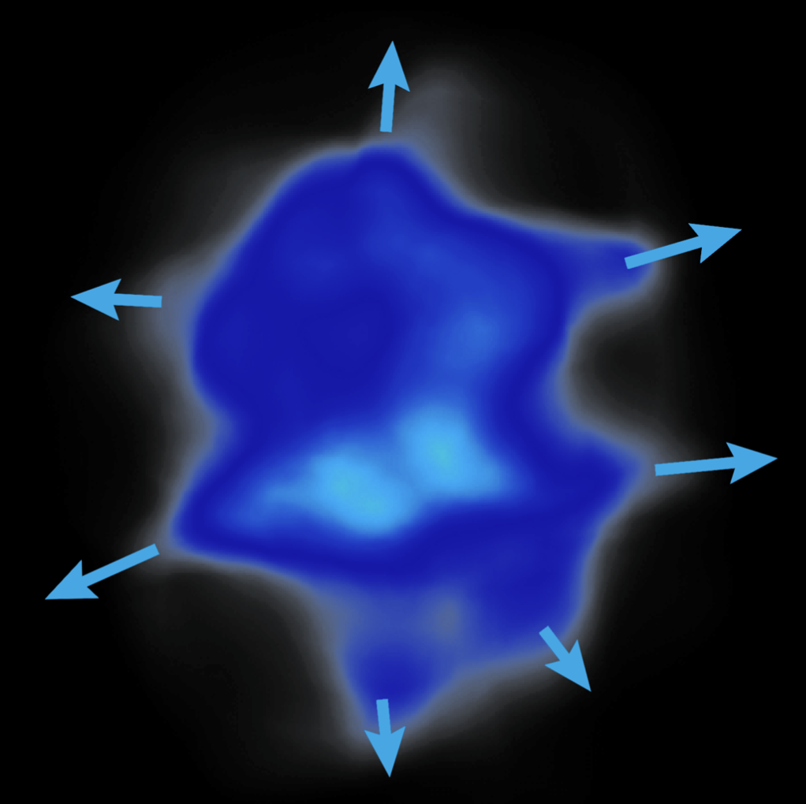
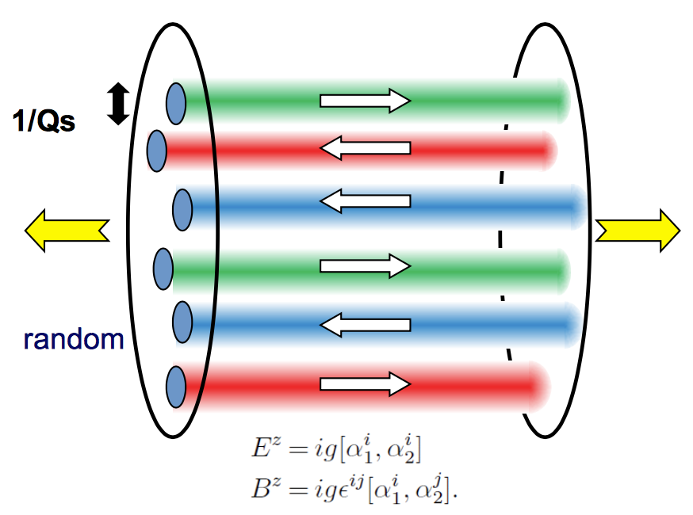
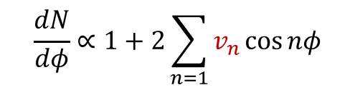

Long-range azimuthal correlation
Nature of sources seeding the long-range collective behaviors?
$$\frac{dN}{dφ}∝1+2\sum_{n=1}{v_{n}\cos{nφ}}$$
Azimuthal correlation in A+A: collective hydrodynamic expansion of nuclear matter;
More careful studies in $pp$ collisions are needed!
Final state correlations
Initial state correlations

Slide 18
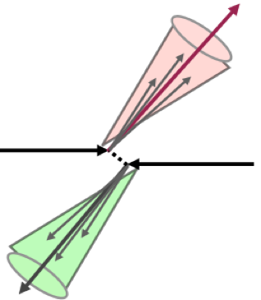
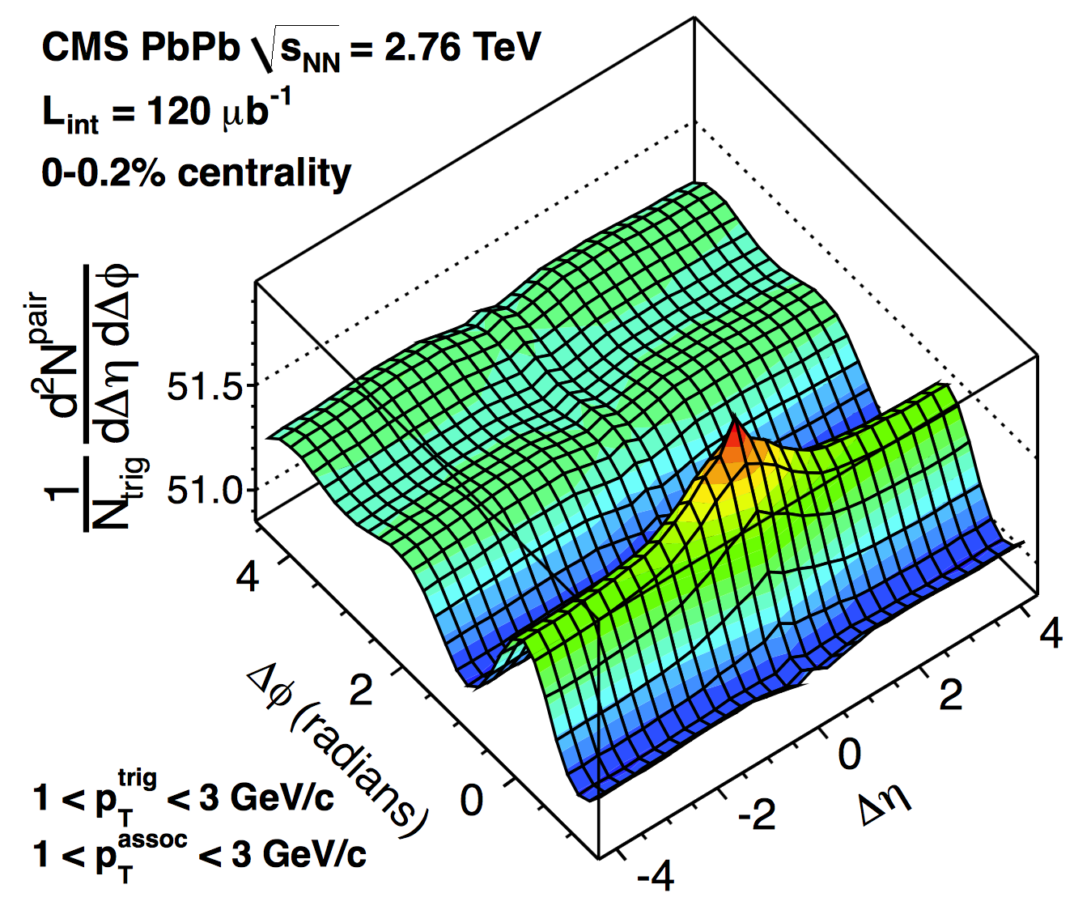
2-particle correlation
Back-to-back jet
Pb+Pb
pp
Short-range non-flow
Long-range collectivity
Dijet behaves like long-range collectivity;
Different methods used to remove dijet.

Slide 19
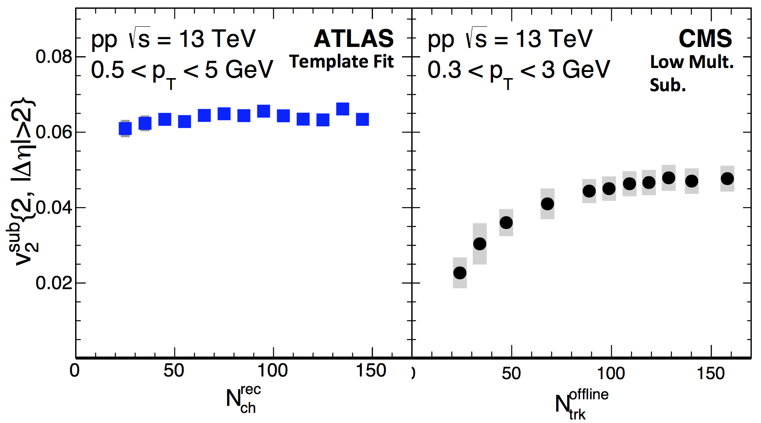
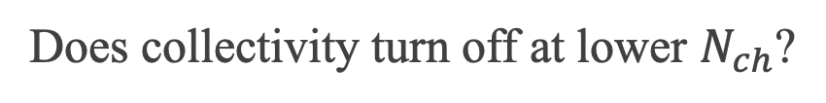
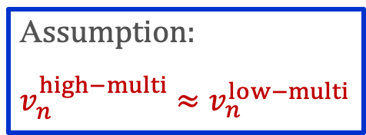
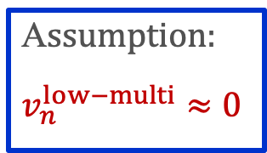
ATLAS v.s. CMS
A$ssumption$:
$$v_{n}^{high−multi}≈v_{n}^{low−multi}$$
A$ssumption$:
$$v_{n}^{low−multi}≈0$$
Does collectivity turn off at lower $N_{ch}$?

Slide 20
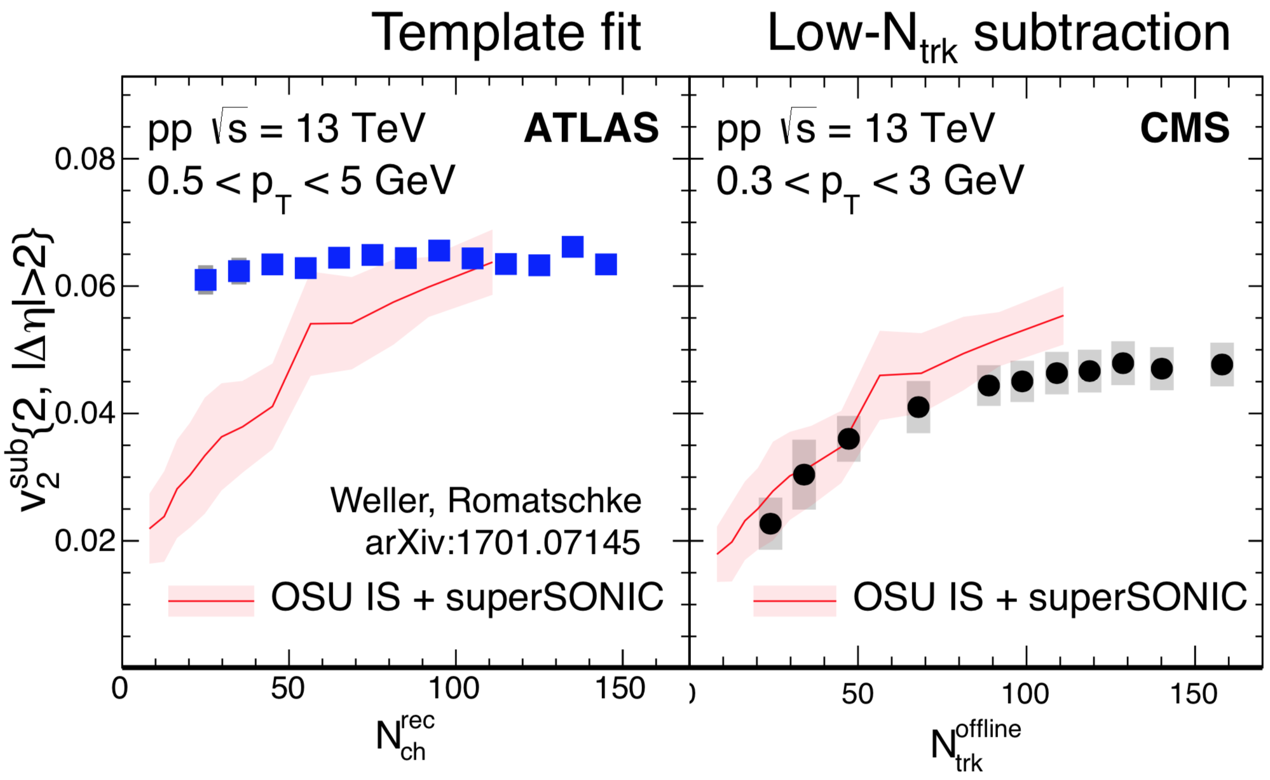
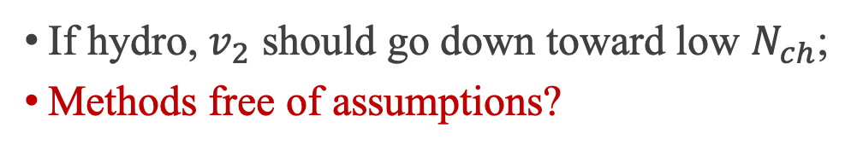
Hydro prediction
If hydro, $v_{2}$ should go down toward low $N_{ch}$;
Methods free of assumptions?

Slide 21
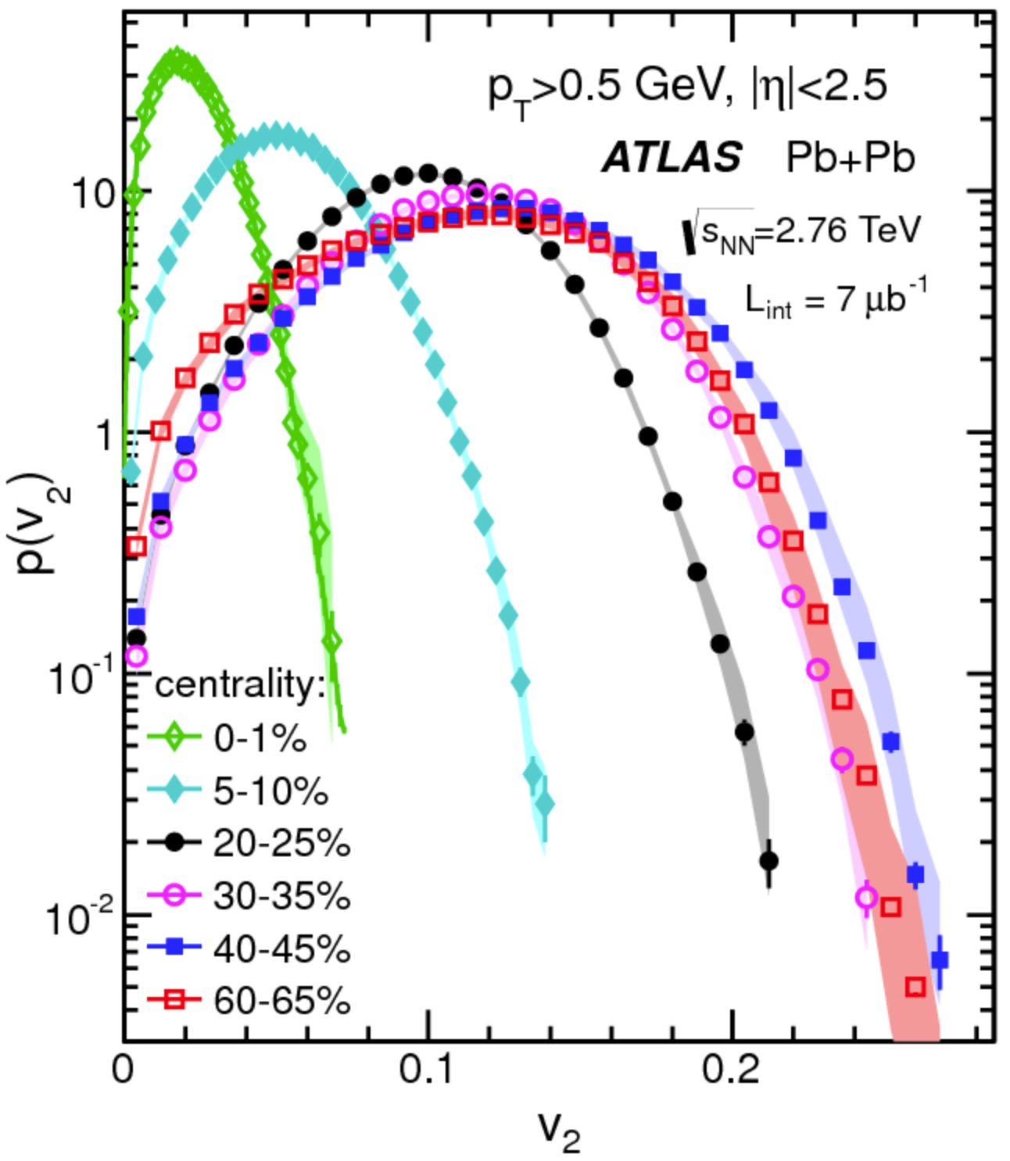
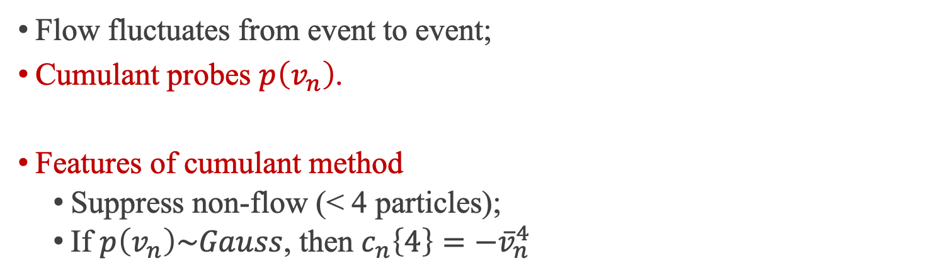
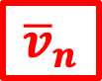

Cumulant method
Multi-particle correlation ${corr}_{n}\left\{4\right\}≡\left\langle e^{in\left(φ_{1}+φ_{2}−φ_{3}−φ_{4}\right)}\right\rangle$
Genuine 4-particle correlation
2-particle non-flow
Multi-particle cumulant $c_{n}\left\{4\right\}≡\left\langle {corr}_{n}\left\{4\right\}\right\rangle −2{\left\langle {corr}_{n}\left\{2\right\}\right\rangle }^{2}$
Flow fluctuates from event to event;
Cumulant probes $p\left(v_{n}\right)$.
Features of cumulant method
Suppress non-flow (< 4 particles);
If $p\left(v_{n}\right)\sim Gauss$, then $c_{n}\left\{4\right\}=−{\overline{v}}_{n}^{4}$
$$δ_{n}$$
Cumulant proved successful in large systems, how about small systems?
$${\overline{v}}_{n}$$
JHEP11 (2013) 183

Slide 22
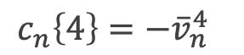
Results
Eur. Phys. J. C 77 (2017) 428
ATLAS
$$c_{n}\left\{4\right\}=−{\overline{v}}_{n}^{4}$$
CMS
To be collective, or not to be collective?

Slide 23


Other puzzles
Phys. Lett. B 765 (2017) 193
No hint of collectivity at lower energy?
$v_{2}\left\{2\right\}=v_{2}\left\{4\right\}+$ flow fluc
Flow fluc $≈$ 0 ?
Puzzles needs to be solved before testing models with data.

Slide 24

Signal or background?
Signal: collectivity
Background: dijets
Maybe background is the one to blame?

Slide 25




Test of background
non-flow
4% $v_{2}$
6% $v_{2}$
$$c_{n}\left\{4\right\}=−{\overline{v}}_{n}^{4}$$
Traditional cumulant cannot remove non-flow in $pp$

Slide 26





Traditional method
$$⇒ c_{2}\left\{4\right\}$$
Background
$$φ$$
$$η$$
High probability all four particles come from background;
Solution: higher-order cumulant (statistical significance), or…

Slide 27

Subevent method
$$⇒ c_{2}\left\{4\right\}$$
Background
$$φ$$
$$η$$
$$3>2$$

Slide 28

Validation in $pp$ PYTHIA
4% $v_{2}$
6% $v_{2}$
Subevent method can suppress non-flow in PYTHIA

Slide 29

Validation in $p$+Pb data
4% $v_{2}$
Large
non-flow
Small
non-flow

Slide 30

$c_{2}\left\{4\right\}$ in $pp$
Hydro?
4% $v_{2}$
4% $v_{2}\left\{4\right\}$ observed in $pp$!

Slide 31





Test of residual non-flow
$$c_{2}\left\{4\right\}≡{\left\langle nonflow+flow\right\rangle }_{evt}$$
Non-flow changes greatly EbyE
Flow changes little EbyE
non-flow fluc. $←$ multiplicity fluc. $←$ how ${\left\langle …\right\rangle }_{evt}$ is defined: $N_{ch}^{Sel}$
$N_{ch}^{Sel}$ defined with different $p_{T}$: very different non-flow fluctuation.
$N_{ch}^{Sel}$ defined with $0.3<p_{T}<3.0$ GeV
$N_{ch}^{Sel}$ defined with $p_{T}>0.4$ GeV
Non-flow fluctuation might mimic the flow signal (negative $c_{2}\left\{4\right\}$)!

Slide 32




Puzzle 1: $N_{ch}^{sel}$ dependence
Different f$or N_{ch}^{sel}$
Different $N_{ch}^{Sel}$
Different non-flow fluctuation
Different $c_{2}\left\{4\right\}$
?
?
non-flow fluctuation
4% $v_{2}$
?
Less non-flow
Weaker non-flow fluctuation
Weaker $N_{ch}^{Sel}$ dependence
Data-driven method to test residual non-flow

Slide 33

Puzzle 2: energy dependence
Weak energy dependence in $pp$;
$p$+Pb has larger flow than $pp$;

Slide 34




Puzzle 3: flow fluctuation
$v_{2}\left\{2\right\}$ from template fit
$v_{2}\left\{4\right\}$ from 3 subevent
$v_{2}\left\{2\right\}$ from peripheral sub.
$v_{2}\left\{4\right\}<v_{2}\left\{2\right\}$ (template fit): flow fluctuation;
$v_{2}\left\{4\right\}≈v_{2}\left\{2\right\}$ (peripheral sub.): underestimation of $v_{2}\left\{2\right\}$;
Subevent cumulant is free of assumptions.

Slide 35





Number of sources
$v_{2}\left\{2\right\}≠v_{2}\left\{4\right\}$: EbyE flow fluctuations associated with fluctuating initial conditions. Phys. Rev. Lett. 112, 082301 (2014)
Fluctuation can be quantified to the number of sources $N_{s}$ in the initial stage:
$$\frac{v_{2}\left\{4\right\}}{v_{2}\left\{2\right\}}={\left(\frac{4}{3+N_{s}}\right)}^{1/4}$$
$$\frac{N\left(η\right)}{\left\langle N\left(η\right)\right\rangle }≈1+a_{1}η, a_{1}∝1/{\sqrt{N_{s}}}$$
$N_{s}$?
azimuthal
longitudinal
$N_{s}$ for $p$+Pb goes up to 20 at high multiplicity;
$N_{s}$ for $pp$ approximately consistent with $p$+Pb at comparable $\left\langle N_{ch}\right\rangle$ value.

Slide 36



Nucleon substructure fluctuation
Pb
p

Slide 37


Non-non-flow $≠$ Flow!

Slide 38



Third harmonic $v_{3}$
$c_{3}\left\{4\right\}$ is consistent with 0
${\overline{v}}_{3}≪{\overline{v}}_{2}$?
Fluctuation kills $v_{3}\left\{4\right\}$?
More statistics needed.

Slide 39
$v_{3}$ projected in Run 3
Opportunity luminosity increase in Run 3;
Challenges trigger, pileup, tracking...

Slide 40

Correlation between $v_{n}$ and $v_{m}$
$${nsc}_{n,m}\left\{4\right\}=\frac{\left\langle v_{n}^{2}v_{m}^{2}\right\rangle −\left\langle v_{n}^{2}\right\rangle \left\langle v_{m}^{2}\right\rangle }{\left\langle v_{n}^{2}\right\rangle \left\langle v_{m}^{2}\right\rangle }$$
Phys. Lett. B 789 (2019) 444
Same sign, different magnitudes across systems;
Independent constrains on models.

Slide 41


Last puzzle: $N_{ch}$ dependence
Weak independence of $N_{ch}$;
Similar observation in model
No “geometry” in $pp$?
$N_{ch}$ not a good indicator for centrality?
Phys. Rev. C 94, 024919 (2016)

Slide 42

Centrality fluctuation
Centrality quantifies the overlap region of the collision;
The mapping replies on model and is on the average level;
Different centrality definitions gives different dependence.

Slide 43

Summary
Nature of sources seeding the long-range collective behavior?
Longitudinal
correlation
Azimuthal
correlation
Evidence of collectivity in small systems!

Slide 44






Summary
Hypothesis
Collectivity in $pp$?
$v_{3}\left\{4\right\}$?
Data Gather
Real-time selection
Standard cumulant
Puzzles
Negative $c_{2}\left\{4\right\}$
Data Analysis
Large background
HMT trigger
ATLAS
New Algorithm
$$3>2$$
Hints of ridge
Subevent cumulant
CMS
Conclusion
Collectivity in $pp$!
Outlook
Other observables

Slide 45
Backup
Forward-backward multiplicity correlation;
Flow and centrality fluctuation;
Novel collision system Xe+Xe.

Slide 46
Forward-backward multiplicity fluctuation

Slide 47

Motivation: a historical view
Rapidity correlations is an old story
ISR
UA5
UA5
E735
PHOBOS
STAR
ATLAS
ALICE
1976
1983
1988
1995
2006
2009
2012
2015
Year
Physics goal: understand production mechanism in early stage.
More details see the thesis.
Why we come back to this analysis?
Previous methods focused on limited phase space: $η$ and $−η$;
We used a new observable that covers full $η$ space;
Short-range correlation and statistical dilution;
We estimated short-range correlation;
Few direct comparisons among different systems;
We compared from large to small systems.

Slide 48




Pb+Pb, $p$+Pb and $pp$ datasets
Correlation functions calculated using charged particles $p_{T}>0.2$ GeV;
High-multiplicity track (HMT) trigger used to increase statistics;
Analysis carried out in many bins over $10≤N_{ch}^{rec}<300$;
Results presented as a function efficiency-corrected values $N_{ch}$.
How long-range correlation compare among three systems, at the same $N_{ch}$?

Slide 49



Legendre expansion: $a_{0}$
$$a_{0}$$
Analysis focuses on dynamical fluctuation upon average;
However, average multiplicity changes with centrality;
The residual centrality dependence is removed by normalizing $C\left(η_{1},η_{2}\right)$
$$C_{N}\left(η_{1},η_{2}\right)=\frac{C\left(η_{1},η_{2}\right)}{C_{p}\left(η_{1}\right)C_{p}\left(η_{2}\right)}$$

Slide 50




Charge dependence of $C\left(η_{1},η_{2}\right)$
Particles from the same source (SRC) have strong charge dependence.
$$η_{+}≡η_{1}+η_{2}$$
Opposite
charges
Same
charges
$$\frac{oppo}{same}$$
Ratio of opposite to same charges $R\left(η_{1},η_{2}\right)$
Very strong Gaussian-like SRC;
Very weak LRC: charge-independent;
Amplitude of $R\left(η_{1},η_{2}\right)$ along $η_{+}$: $f\left(η_{+}\right)$, reflects the strength of SRC in the longitudinal direction;
Assumption: strength of SRC along $η_{+}$ is same for same charge and opposite charge.

Slide 51




Estimation of short-range correlation
To estimate SRC, LRC pedestal is estimated first.
SRC
Same
charges
$C\left(η_{1},η_{2}\right)$ from same charge used to estimate LRC pedestal because of small SRC;
LRC pedestal is fitted with quadratic function;
The additional structure upon LRC pedestal determines the shape of SRC;
The full $δ_{SRC}\left(η_{1},η_{2}\right)$ is then populated using $f\left(η_{+}\right)$ scaling.

Slide 52





Legendre expansion: from $a_{n}$ to $\left\langle a_{n}a_{m}\right\rangle$
Expansion of correlation function $C_{N}\left(η_{1},η_{2}\right)$
$$1+\sum_{n.m=1}^{∞}{\left\langle a_{n}a_{m}\right\rangle \frac{T_{n}\left(η_{1}\right)T_{m}\left(η_{2}\right)+T_{n}\left(η_{2}\right)T_{m}\left(η_{1}\right)}{2}}$$
$$η_{+}$$
If linear shape dominates:
$$C_{N}\left(η_{1},η_{2}\right)=1+\left\langle a_{1}^{2}\right\rangle η_{1}η_{2}$$
Expressed as $η_{+}$ and $η_{−}$:
$$C_{N}\left(η_{1},η_{2}\right)=1+\frac{\left\langle a_{1}^{2}\right\rangle }{4}\left(η_{+}^{2}−η_{−}^{2}\right)$$
$$η_{−}$$

Slide 53




Results: correlation function
Raw
$$C_{N}\left(η_{1},η_{2}\right)$$
=
Short-range
$$δ_{SRC}\left(η_{1},η_{2}\right)$$
+
Long-range
$$C_{N}^{sub}\left(η_{1},η_{2}\right)$$
Pb+Pb
p+Pb
pp

Slide 54




Other methods to measure $\left\langle a_{1}^{2}\right\rangle$
$$C_{N}\left(η_{1},η_{2}\right)$$
Expansion of $C_{N}^{sub}\left(η_{1},η_{2}\right)$
$$C_{N}^{sub}\left(η_{1},η_{2}\right)=1+\left\langle a_{1}^{2}\right\rangle η_{1}η_{2}$$
Quadratic fit along $C_{N}^{sub}\left(η_{−}\right)$
$$C_{N}^{sub}\left(η_{−} \right)=1+\frac{\left\langle a_{1}^{2}\right\rangle }{4}\left(η_{+}^{2}−η_{−}^{2}\right)$$
Quadratic fit along $C_{N}^{sub}\left(η_{+}\right)$
$$C_{N}^{sub}\left(η_{−} \right)=1+\frac{\left\langle a_{1}^{2}\right\rangle }{4}\left(η_{+}^{2}−η_{−}^{2}\right)$$
Linear fit of $r_{N}^{sub}\left(η,η_{ref}\right)≡\frac{C_{N}^{sub}\left(−η,η_{ref}\right)}{C_{N}^{sub}\left(η,η_{ref}\right)}$
$$r_{N}^{sub}\left(η,η_{ref}\right)=1−2\left\langle a_{1}^{2}\right\rangle ηη_{ref}$$
LRC
SRC
$$η_{1}$$
LRC
$$η_{2}$$
Four methods have different responses of the analysis procedures, and are largely independent.

Slide 55


How stable are the results?
Four largely independent methods are applied to determine $\left\langle a_{1}^{2}\right\rangle$;
Different methods have different sensitivity to the analysis procedures;
Four methods give consistent $a_{1}$: conclusions are insensitive to the procedure.

Slide 56






Asymmetry in $p$+Pb collision
$$p$$
$$SRC$$
Asymmetry entirely due to SRC!
$$p$$
$$p$$
$$LRC$$
Asymmetry observed in p+Pb collision: stronger correlation in the proton-going side.
LRC is symmetric.
Why the asymmetric collision causes asymmetric SRC?

Slide 57




SRC asymmetry in $p$+Pb collision
$$p$$
$$p$$
Assume there are $n$ clusters and each one emits $m$ particles on average;
Assume $n$ is proportional to local particle density ${dN_{ch}}/{dη}$;
$$δ_{SRC}∝\frac{n\left\langle m\left(m−1\right)\right\rangle }{{\left(n\left\langle m\right\rangle \right)}^{2}}=\frac{1}{n}∝\frac{1}{{dN_{ch}}/{dη}}$$
Inverse to multiplicity distribution

Slide 58

Compare SRC shape in three systems
Symmetrized p+Pb
pp
Pb+Pb
For better comparison with pp and Pb+Pb, p+Pb is symmetrized;
In high-multiplicity pp, SRC shape is slightly larger than p+Pb;
However in Pb+Pb, SRC shape is more flat.
EbyE asymmetry of multiplicity (relative to average multiplicity) in high-multiplicity pp is larger than p+Pb while Pb+Pb collision is more symmetric.

Slide 59







Outlook
$C\left(η_{1},η_{2}\right)$ is a very comprehensive observable.
Reconstruct balance function
$$2B\left(Δη\right)≡2C^{+−}\left(Δη\right)−C^{++}\left(Δη\right)−C^{−−}\left(Δη\right)$$
Test factorization: high-$p_{T}$ $a_{n}^{H}$ and low-$p_{T}$ $a_{n}^{L}$
$$r_{n}≡\frac{\left\langle a_{n}^{H}a_{n}^{L}\right\rangle }{\sqrt{\left\langle a_{n}^{H}a_{n}^{H}\right\rangle }\sqrt{\left\langle a_{n}^{L}a_{n}^{L}\right\rangle }}$$
$$C\left(η_{1},η_{2}\right)$$
+
$C\left(η_{1},η_{2},Δφ\right)$ !
$$C\left(Δη,Δφ \right)$$

Slide 60
Centrality fluctuation

Slide 61



Ultra-Central Collision (UCC)
Cent.
2%
1%
0.1%
In UCC: ${\overline{v}}_{2}→0$, largest relative flow fluctuation;
ATLAS applied UCC triggers: $×$20 statistics over MinBias;
$c_{2}\left\{4\right\}>0$ in UCC $⇒$ non-Gaussian flow fluctuation
Why?

Slide 62






Initial stage and hydro response
PLB 659 (2008) 537-541
PRC 87 (2013) 054901
Hydro
Gaussian $p\left(ε_{2}\right)$
$$v_{2}\sim ε_{2}$$
Glauber 20-30%
$$v_{n}\left\{4\right\}={\overline{v}}_{n}=\sqrt[4]{−c_{n}\left\{4\right\}}$$
On the model side
Gaussian $p\left(ε_{2}\right)⇒$ Gaussian $p\left(v_{2}\right)⇒$ $c_{2}\left\{4\right\}≤0$
But we observed $c_{2}\left\{4\right\}>0$
Non-flow contribution?

Slide 63

Non-flow contribution?
Cent.
2%
1%
0.1%
Two methods consistent: not due to non-flow.
Pileup effects have also been suppressed.

Slide 64




Centrality (volume) Fluctuation (CF)
Initial stage sources $N_{part}$
Final stage particles $N_{ch}$
Not detector effect!
Fluctuation of particle production $p\left(n\right)$
Same $N_{part}⇒$ different $N_{ch}$
Same $N_{ch}⇒$ different $N_{part}$
In the experiment
First calculate $𝒪bs\left(N_{ch}\right)$
Then map to $\left\langle N_{part}\right\rangle$
Flow is driven by initial stage $N_{part}$
$𝒪bs\left(\left\langle N_{part}\right\rangle \right)$ introduces CF
CF affects all fluctuation measurements, but never been studied in flow
$$p\left(n\right)$$

Slide 65








How to test centrality fluctuation in data?
$$c_{n}\left\{4\right\}≡\left\langle \left\langle 4\right\rangle \right\rangle −2{\left\langle \left\langle 2\right\rangle \right\rangle }^{2}$$
Binning defined by | Observable
FCal: $3.2<\left|η\right|<4.9$ | $$c_{2}\left\{4,ΣE_{T}\right\}$$
ID: $\left|η\right|<2.5, p_{T}$ cut | $$c_{2}\left\{4,N_{ch}^{rec}\right\}$$
Calculated event-by-event
Averaged over many events
Particle production depends on $η$
Test relative CF by comparing $c_{2}\left\{4\right\}$ binned by $ΣE_{T}$ and $N_{ch}^{rec}$
$$N_{part}$$
$p\left(N_{ch}^{rec}\right)$broader than $p\left(ΣE_{T}\right)$
CF effect: $ΣE_{T}<N_{ch}^{rec}$
Prediction
$c_{2}\left\{4,ΣE_{T} \right\}<c_{2}\left\{4,N_{ch}^{rec}\right\}$
$$ΣE_{T}$$
$${ N}_{ch}^{rec}$$
arXiv:1803.01812

Slide 66


$c_{2}\left\{4\right\}$ and centrality fluctuation
Cent.
2%
1%
0.1%
$c_{2}\left\{4,{ΣE}_{T} \right\}<c_{2}\left\{4,N_{ch}^{rec}\right\}$: CF affects flow cumulant;
$c_{2}\left\{4\right\}→0$ in very most-central: smaller CF effect;

Slide 67



From ultra-central to full centrality
$$c_{2}\left\{4\right\}$$
$$c_{3}\left\{4\right\}$$
$c_{2}\left\{4\right\}$: CF mostly affects central;
$c_{3}\left\{4\right\}$: CF affects most centralities.

Slide 68
Comparison between Pb+Pb and Xe+Xe

Slide 69

Xe+Xe and Pb+Pb: $v_{2}$
Mass number of Xe is halfway of Pb and $p$;
If $v_{2}\sim Gauss\left({\overline{v}}_{n},δ_{n}\right)$: ${v_{2}\left\{6\right\}}/{v_{2}\left\{4\right\}}=1$
$v_{2}$ in Xe+Xe deviates further from Gauss: deformed nucleus?

Slide 70

Xe+Xe and Pb+Pb: $v_{3}$
$c_{3}\left\{4\right\}$ doesn’t scale with centrality between Xe and Pb
No avg. geometry for $v_{3}$;
$c_{3}\left\{4\right\} s$cales with $\left\langle N_{part}\right\rangle$
Fluctuation driven by # of sources $N_{part}$
Similar observation for $c_{4}\left\{4\right\}$ (see backup)

Slide 71
Multi-particle cumulant

Slide 72
Differential cumulant

Slide 73
Symmetric cumulant

Slide 74
$$c_{2}\left\{4\right\}$$

Slide 75
$$c_{3}\left\{4\right\}$$

Slide 76
Title

Slide 77



Origins of collectivity
$$\frac{dN}{dφ}=G\left(1+2\sum_{n=1}{v_{n}\cos{nφ}}\right)$$
Final state correlations
Hydrodynamic flow
Spatial structure from initial condition
Momentum correlations
More careful studies in $pp$ collisions are needed!
Initial state correlations
Particles are produced with momentum space correlations

Slide 78
Final note
O+O to O+O

